Slide 1
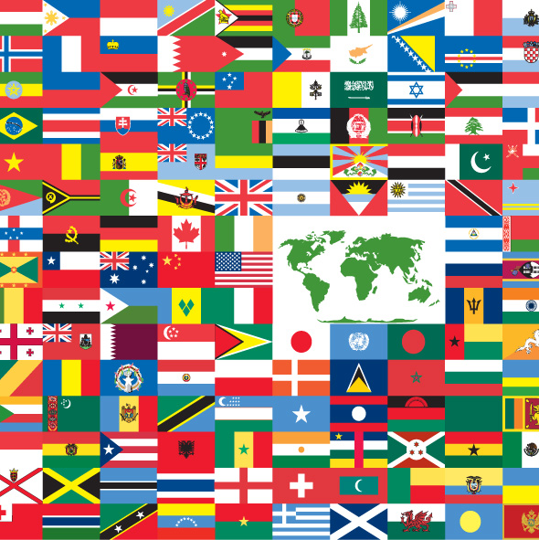
INSIGHTS FROM WORLD HAPPINESS REPORT (2012-2022)
Project Group 1:
Andrea Aurrecoechea Diaz
Bhumika Dalal
Michael Lee
This Photo by Unknown author is licensed under CC BY-SA.
Notes:
Hi Everyone myself Bhumika. Today my team mates and I are going to present our project which is on the Insights from the world happiness report which includes data from year 2012 – 2022. I would like to thank Andrea and Michael for being such superb team work and support throughout the project .

Slide 2
Background
Affect of COVID-19 on the quality of life.
Happiness Report 2023
Gallup World Poll
150 countries
98% world adult population
1000 individuals per country
Face-to-face / telephone interviews.
Standard set of Core questions
Depression vs Happiness & Income
Notes:
Before moving on I would like to brief u all on our thought process…. behind choosing this topic.
Soo….While brainstorming for our project we all discussed various ideas and one of which was……. how COVID could have affected the quality of life for people around the world.
So, we browsed for various data sets on the internet….and it was very difficult to get data for different countries pre and post covid related to factors that define quality of life and on top of that we were short on time.
Finally, we found the World happiness Report 2023 which uses Gallup world poll data to create this report annually.
Gallup is a global analytical and advisory firm that conducts the World poll around 150 countries representing more than 98% of the world’s adult population, using randomly selected, nationally representative samples. Survey 1,000 individuals in each country using a standard set of core questions through Face-to-face interviews/ telephone interviews.
But …There was one thing missing in the data set which is a good indicator of quality of life that is mental health….. so we merged Depression data around the world to run some extra evaluations.

Slide 3
Data Source/ Methodology
Pandas
Geo API
World Happiness Report
Depression Data set
Notes:
We used pandas from python to conduct some basic statistical analysis of the data set
API
What API was used and the library used to plot the world map
Merged with the depression data set
126 countries in 2012
131 countries in 2019
106 countries in 2020
104 countries in 2022

Slide 4

Happiness
World Happiness Report
Happiness score
Please imagine a ladder, with steps numbered from 0 at the bottom to 10 at the top. The top of the ladder represents the best possible life for you and the bottom of the ladder represents the worst possible life for you.
Healthy Life Expectancy
Healthy life expectancies at birth are based on the data extracted from the World Health Organization’s (WHO) Global 1 Health Observatory data repository
GDP per Capita
in purchasing power parity (PPP) at constant 2017 international dollar prices are from World Development Indicators
Social Support
If you were in trouble, do you have relatives or friends you can count on to help you whenever you need them, or not?”
Notes:
Following are few of the data variable that were used in the happiness report data – 1 Happiness score - being a subjective measure of the life evaluation in which the respondent is asked to imagine a ladder with steps numbered from 0 at the bottom to 10 at the top. The top of the ladder represents the best possible life for you and the bottom of the ladder represents the worst possible life for you.
2. GDP per capita in 2022 was not available when the report came out and therefore the GDP forcast for 2022 from OECD Economic Outlook No. 112 (November 2022) and World Bank’s Global Economic Prospects were used.
3. Social support: Social support (or having someone to count on in times of trouble) is the national average of the binary responses (either 0 or 1) to the GWP question “If you were in trouble, do you have relatives or friends you can count on to help you whenever you need them, or not?”
4. The data at the source are available for the years 2000, 2010, 2015 and 2019. To match this report’s sample period (2005-2021), interpolation and extrapolation are used. i.e. The data at the source are available for the years 2000, 2010, 2015 and 2019. To match this report’s sample period (2005-2021), interpolation and extrapolation are used.
Depression data included the - % of population living with depression

Slide 5
Acknowledge Limitations
1000 individuals per country
Face-to-face / telephone interviews –
Leading questions
Bias based on social desirability
Emotional state of the individual
People with no telephone
Missing information
Notes:
1000 individuals is not a good indicator of the population of all countries as countries with higher population won't give the same data comparted to the countries with lower population
There are few limitations of the interview methods including
Leading questions: Participants may give answers that are not completely accurate because interviewers ask questions that suggest a particular answer.
Bias based on social desirability: Rather than giving their true opinions or experiences, participants may feel pressured to answer as the interviewer wants.
There were few variable where the data was not available as discussed in the previous slides.

Slide 6

Project Questions
Has the World Happiness increased or decreased after pandemic?
Is there a relationship between life expectancy and the happiness score?
Is Wealth related to happiness and rate of depression?
Are countries with higher happiness score found to have lower rates of depression?
Does geographical location of a country affect the happiness index and depression rate?

Slide 7

Has the World Happiness increased or decreased after pandemic?

Slide 8
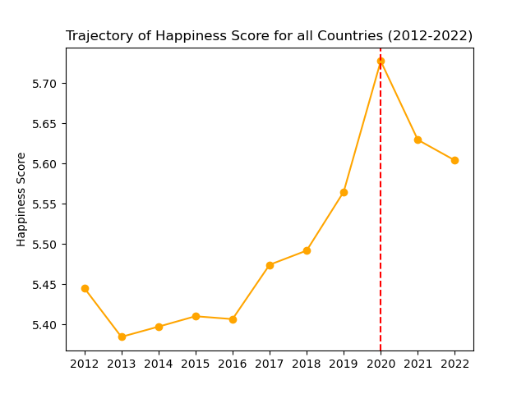
What happened to the average happiness Score during the Pandemic?
2020 Happiness Score
2.91% increase from 2019
2021 Happiness Score
1.7% decrease from 2020
2022 Happiness Score
2.15% decrease from 2020
Notes:
The first question we had is whether the happiness score had changed at all throughout COVID
To our surprise, we observed an almost 3% increase in the average global happiness score in 2020 compared to 2019. We also observed a slight decrease in the global average happiness score in the years following the pandemic.
We conducted a bit of research to understand why this boost may be the case. And we found that
1. Fewer countries were surveyed in 2020 and 2021
2. Vulnerable groups were often excluded.
3. Survey methods changed from face-to-face to mobile phone. Might changed the demographic of the sample.
4. We learned that there as body of research currently looking at the increases in prosocial behavior and how this may have boosted happiness.
These are other factors could have skewed this data, and it is very likely that this measure does not capture the full impact of the pandemic on well-being

Slide 9
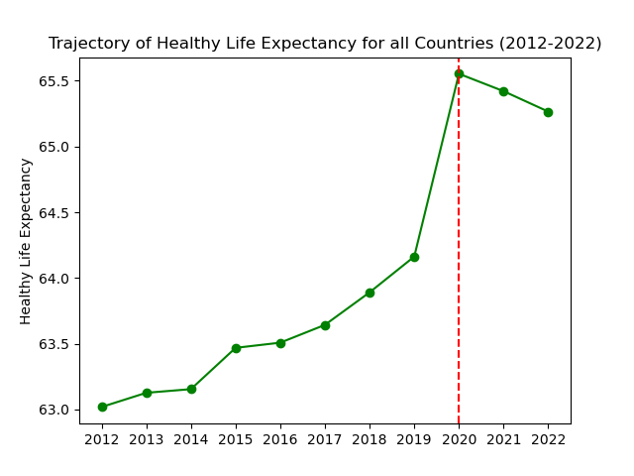
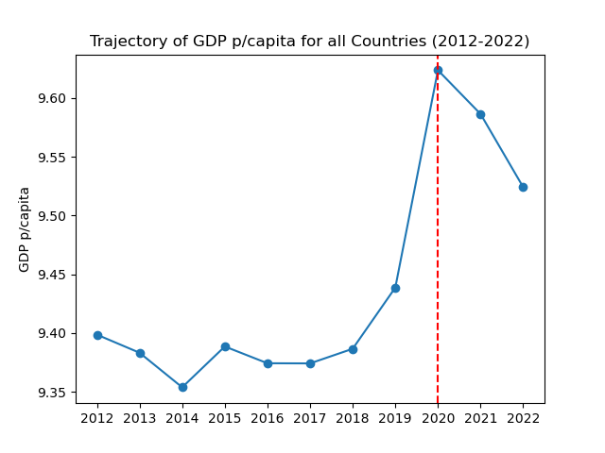
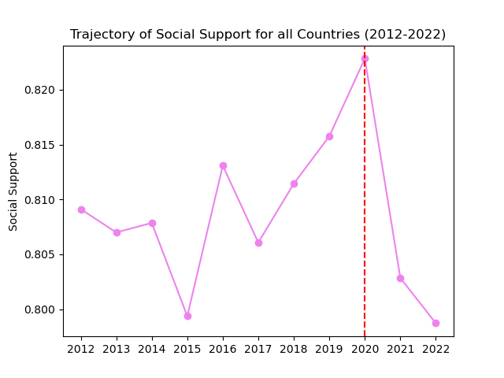
What about other metrics included in the World Happiness Report data?
Notes:
We plotted the fluctuation of other metrics such as healthy life expectancy, GDP p/capita and Social support observing similar behaviours

Slide 10
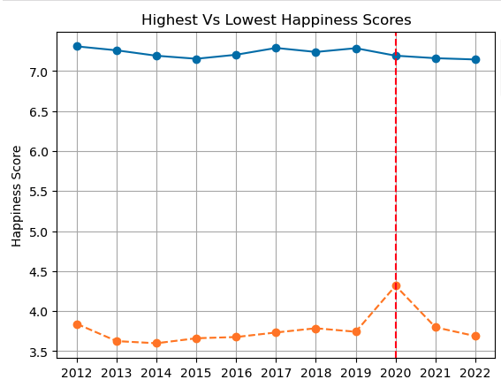
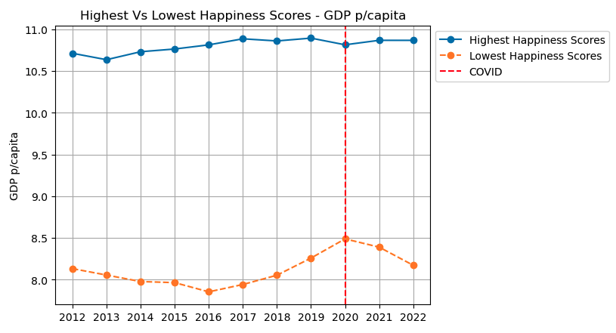
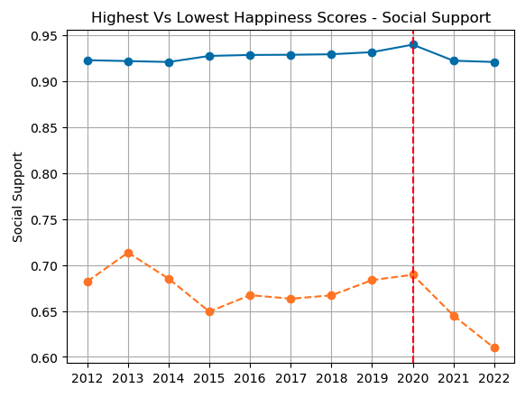
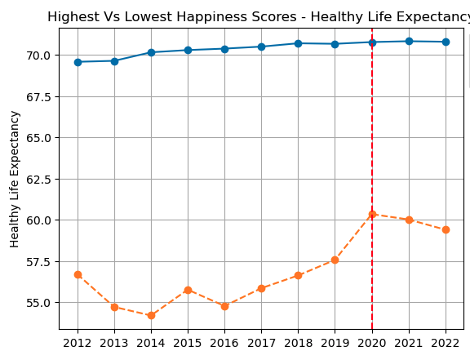
Comparing countries with highest Vs lowest happiness scores.
Notes:
We identified the top 20 countries with the highest and lowest happiness scores for each year and compared their annual averages.
We found that countries scoring high in happiness also performed exceptionally well in metrics like GDP per capita, social support, and healthy life expectancy.
Interestingly, we observed a surge in happiness, GDP per capita, and healthy life expectancy in 2020 for countries ranked at the bottom, in contrast to those at the top.
Additionally, post-2020 trends showed that higher-ranked countries exhibited stronger resilience, particularly in areas like GDP per capita and life expectancy, while the recovery seemed more challenging for countries that were ranked lower."

Slide 11
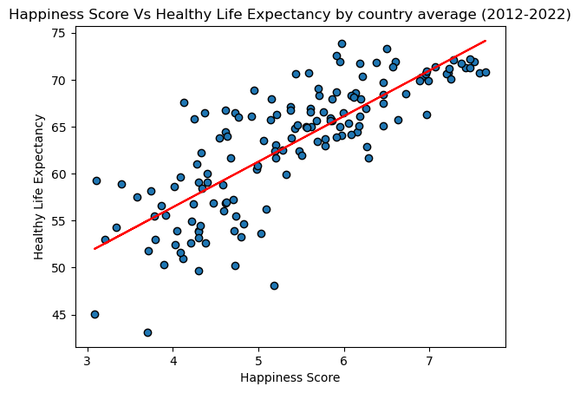
The R-value is:
0.7962789341163952
The R-square value is:
0.6340601409175424

Slide 12
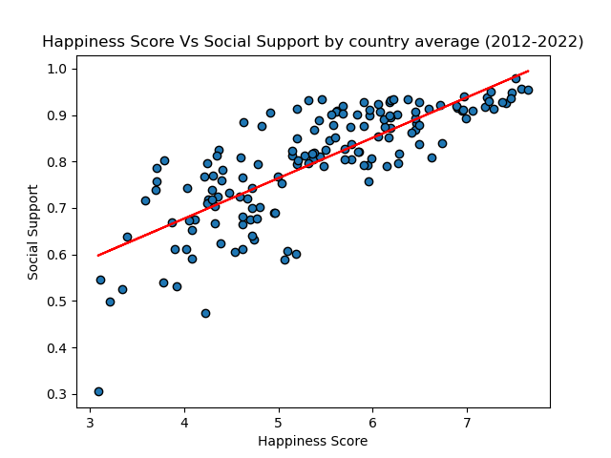
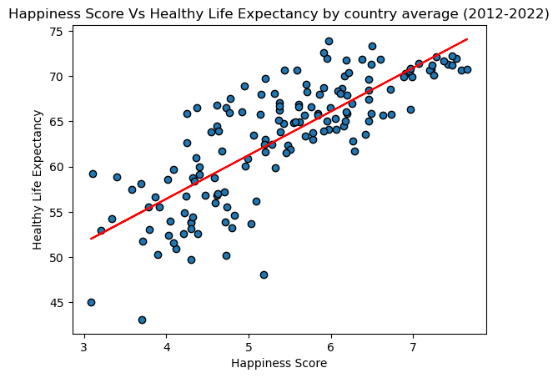
What does this correlation look like for the other metrics?
r-value: 0.7933421788603724
r-square: 0.6293918127589231
r-value: 0.7928088246741942
r-square: 0.6285458324812773
Notes:
We did the same with Social Support and Healthy Life Expectancy and found similar correlations, which could explain why in this data set, countries with higher GDP, life expectancy and social support also have high happiness scores

Slide 13
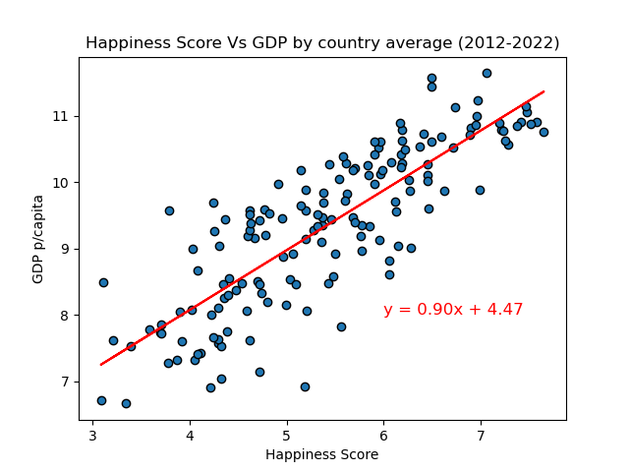
Is there a correlation between GDP p/capita and happiness?
r-value:
0.82910387
r-square value:
0.687413233
Notes:
We subsequently had a look at the correlation, between the happiness score and GDP p/capita and found as relatively strong correlation between these two variables.

Slide 14
What does this correlation look like for the other metrics?
r-value: 0.7933421788603724
r-square: 0.6293918127589231
r-value: 0.7928088246741942
r-square: 0.6285458324812773
Notes:
We did the same with Social Support and Healthy Life Expectancy and found similar correlations, which could explain why in this data set, countries with higher GDP, life expectancy and social support also have high happiness scores

Slide 15
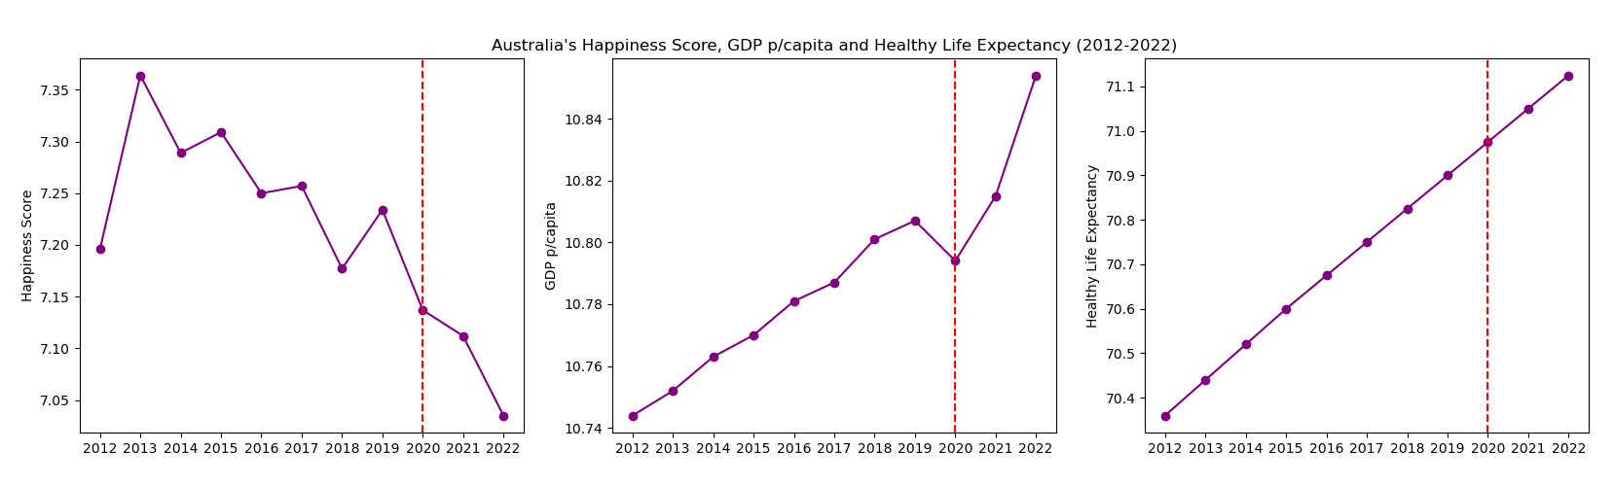
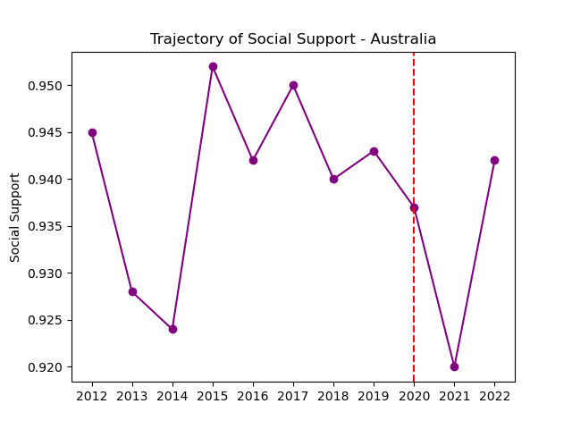
Australia
Notes:
After learning that GDP p/capita, life expectancy and social support has positive correlations with Happiness Score.
We turned to Australia to see what Australia’s behaviour looked like.
We observed that Australia’s happiness score has been slowly decreasing since 2013 despite other metrics showing signs of improvement.
We can also observe how Australia’s GDP p/capita has been increasing since 2012 however the impact of COVID-19 in 2020 and quick recovery there after is evident.

Slide 16

Depression
Is Happiness related to Depression?

Slide 17
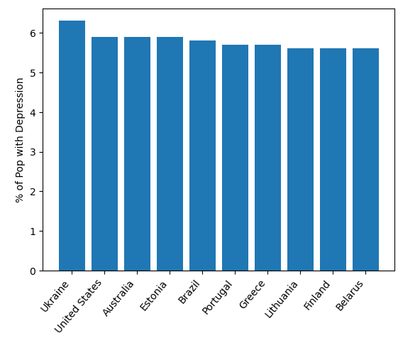
Top 10 Depressed Countries

Slide 18
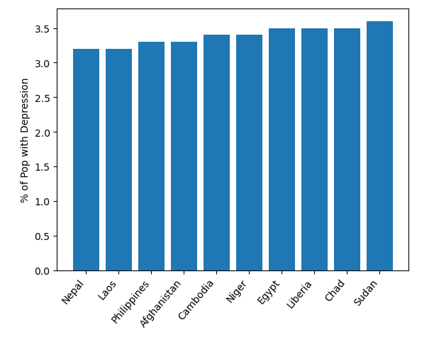
Bottom 10 Depressed Countries

Slide 19
Is Happiness related to Depression?

Slide 20
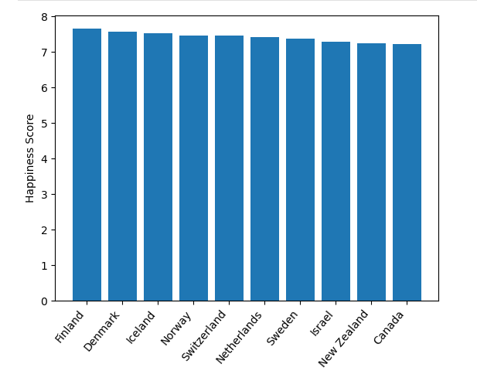
Top 10 Happiest Countries

Slide 21
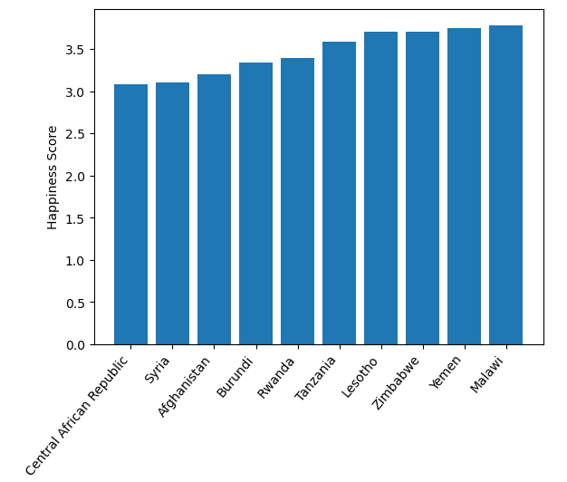
Bottom 10 Happiest Countries

Slide 22

Does geographical location of a country affect the happiness score and depression rate?

Slide 23
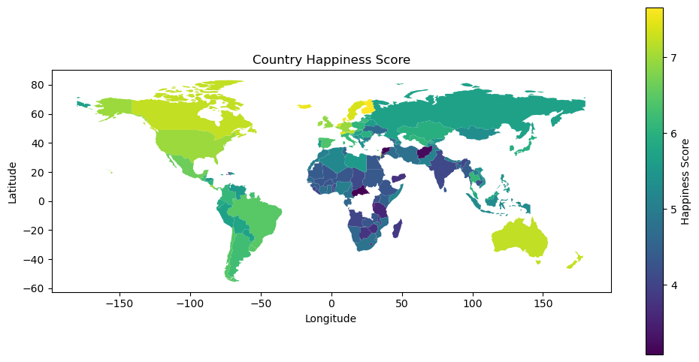

Slide 24
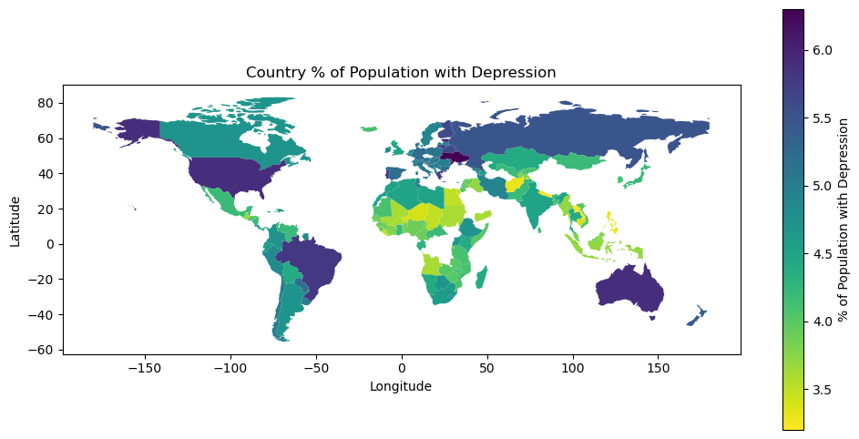

Slide 26
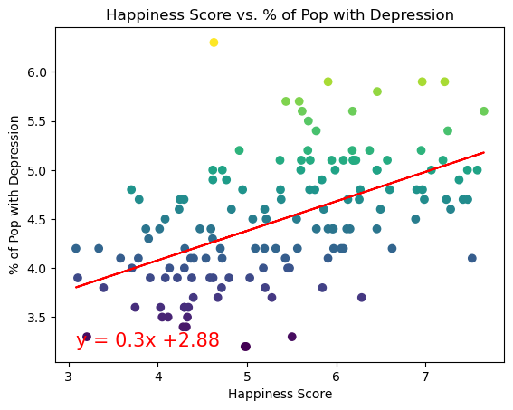
The r-value is: 0.2776394552152004

Slide 27
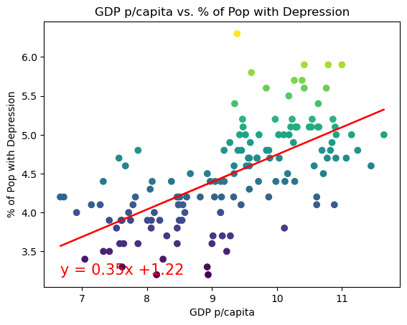
The r-value is: 0.4166441030275225
The r-value is: 0.4166441030275225

Slide 28
Implications
The findings above, aids the government with finding the factors other that income that affects the quality of life of the nation.
The unexpected boost in happiness scores among lower-ranked countries in 2020 might indicate the impact of increased humanitarian and pro-social activity during challenging times. If substantiated through further research, this could serve as evidence for NGOs and policy-makers to broaden the scope of their aid efforts, extending beyond immediate responses to catastrophic events like the COVID-19 pandemic.

Slide 29
Implications
Happiness score does not equate to less depression.
There is no relation to the Happiness and Depression of a country to its location.

Slide 30
Reference
WHR+23_Statistical_Appendix.pdf (happiness-report.s3.amazonaws.com)
DataForTable2.1WHR2023.xls (live.com)
DataForTable2.1WHR2023.xls (live.com)

